Slide 1
Lecture 11
CMM
CSCI – 3350 Software Engineering II
Fall 2014
Bill Pine

Slide 2
Lecture Overview
Examine the SEI CMM
  What is the CMM?
  Why is it relevant?
  What are the levels?

Slide 3
Introduction
The Software Engineering Institute (SEI) develops models of the software development process
What is the SEI?
  The Software Engineering Institute (SEI) is a federally funded research and development center sponsored by the U.S. Department of Defense

Slide 4
Introduction (continued)
What is their mission?
  The SEI mission is to provide the technical leadership to advance the practice of software engineering so the DoD can acquire and sustain its software-intensive systems with predictable and improved
    Cost,
    Schedule, and
    Quality
We will briefly examine the SEI’s work on evaluating a team’s software development process

Slide 5
Capability Maturity Models Integrated
What is the CMMI
  An organized collection of best practices
  A systematic ordered approach to process improvement
  A means of measuring the maturity of an organization
There are several CMMs, organized by discipline
  Software
  Systems
  Acquisitions

Slide 6
CMMI (continued)
Historically, there has not been good integration of systems and software
  Some organizations see themselves as performing just one discipline
    Software
    Systems
    Acquisition
But…
  Software always must be part of some kind of system
  Systems that don’t have software are rare
  Acquisition can involve both
The CMMI is an attempt to integrate software engineering, system engineering, and acquisitions into a single process improvement framework

Slide 7
What Is a Process
A set of practices performed to achieve a specified purpose
It may include
  Tools,
  Methods, and
  Materials
Software development is often viewed as a three legged stool, with the legs
  People
  Technology
  Process
Perhaps a more descriptive view is that Process is the “glue” that hold people and technology together

Slide 8
Why Concentrate on Process?
Process provides a constructive focal point for
  People
    The people are as “good” as they are trained to be
    Work smarter, not harder
    How do you work smarter?
      Improve your process
  Technology
    Throwing technology at a problem, generally has poor payoff
    Technology provides the most benefit when appropriately applied
    Process provides the plan and context to make the best use of the technology

Slide 9
Concentration on Process (continued)
In summary
  “The quality of a product is largely determined by the quality of the process that is used to develop and maintain it.”
    Based on TQM principles as taught by
      Shewhart, Juran, Deming and Humphrey

Slide 10
Two Models
There are two representations
  Continuous
  Staged
Continuous representation
  Allows a software organization to select the order of improvement to best fit
    The organizations business objectives
    The mitigation of the appropriate areas of risk
  Provides a means of comparison on a process area by process area basis

Slide 11
Two Models (continued)
Staged representation
  A proven sequence of improvements based on
    Best management practices
  Provides a way of comparing the relative maturity of software development organizations by a single rating factor
    The maturity level
We will confine our examination to the staged representation

Slide 12
The Maturity Levels
A maturity level is a plateau on the path toward becoming a mature developing organization
There are 5 maturity levels
  Performed
  Managed
  Defined
  Quantitatively Managed
  Optimizing

Slide 13
The Maturity Levels (continued)
Maturity Levels cannot be skipped
  Each level builds upon the previous level
  Higher level processes may be performed by organizations at a lower level
  But frequently, the organization will revert to its “old ways” in a time of crisis

Slide 14
Process Areas
Process Areas (PAs) are clusters of related practices performed collectively to achieve a set of goals
They are the major building blocks in establishing the process capability of an organization
Each process area has been defined to reside at a given maturity level

Slide 15
CMMI Level Definitions (continued)
Level | Name | Focus | Process Areas
2 | Managed | Basic Project Management | Requirements Management Project Planning Project Monitoring and Control Supplier Agreement Management Measurements and Analysis Process and Product Quality Assurance Configuration Management
1 | Performed

Slide 16
CMMI Level Definitions (continued)
Level | Name | Focus | Process Areas
3 | Defined | Process Standardization | Requirements Development Product Integration Verification & Validation Organizational Process Focus & Definition Organizational Training Integrated Project Management Integrated Supplier Management Risk Management Decision Analysis and Resolution

Slide 17
CMMI Level Definitions
Level | Name | Focus | Process Areas
5 | Optimizing | Continuous Process Improvement | Organizational Innovation and Deployment Causal Analysis and Resolution
4 | Quantitatively Managed | Quantitative Management | Organizational Process Performance Quantitative Project Management

Slide 18
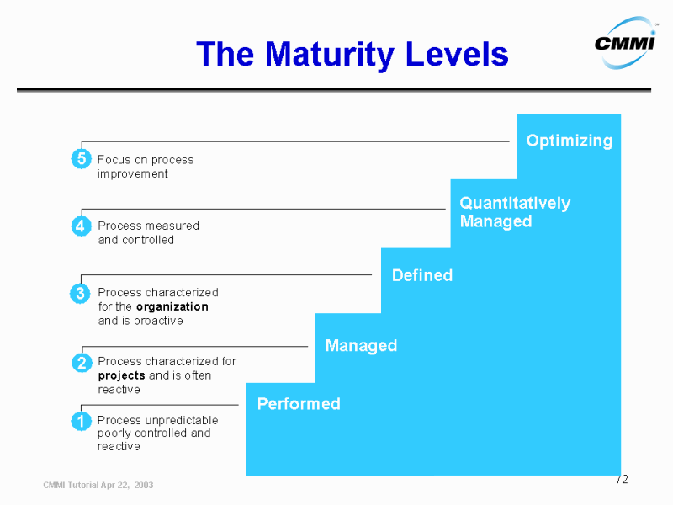
CMMI Levels
Source : http://www.sei.cmu.edu/cmmi/presentations/euro-sepg-tutorial

Slide 19
Maturity Levels In Simple Terms
Maturity Level 1 - Performed
  Requirements flow in
  The product is produced by some undefined process
  The product flows out
  We hope it works

Slide 20
In Simple Terms (continued)
Maturity Level 2 - Managed
  Requirements flow in
  Plans are developed based on policy
  Activities are carried out based on the plans
  Measurement and reviews occur at defined points
  The product flows out
  Usually it works

Slide 21
In Simple Terms (continued)
Maturity Level 3 - Defined
  Requirements flow in
  Processes are tailored from standard defined processes
  Plan are developed and activities carried out according to tailored process
  The product flows out
  Product quality is somewhat predictable

Slide 22
In Simple Terms (continued)
Maturity Level 4 - Quantitatively Managed
  The process behavior is predictable and quantitatively characterized
  A quantitative basis exists for decisions to achieve
    Pre-established product quality
    Service quality
    Process performance goals

Slide 23
In Simple Terms (continued)
Maturity Level 5 - Optimizing
  Continual and measurable process improvement as a part of a stable process is institutionalized

